Slide 1

Latest and Greatest in Visual Studio for C++ developers
Steve.Carroll & Daniel.Moth
@microsoft.com
https://blogs.msdn.microsoft.com/vcblog/

Slide 2

Win an Xbox One S Forza Horizon 3 + Destiny 2 Bundle!
Take this survey: https://aka.ms/cppcon

Slide 3
Mission of C++ Product Team at Microsoft (DevDiv)
Make the lives of all C++ developers on the planet better
by participating with the C++ Standards committee
by investing in the Microsoft Visual C++ (MSVC) Compiler
by improving the Visual Studio IDE
by continuing to enhance the C++ extension for Visual Studio Code

Slide 4

Visual Studio Code: C/C++ Extension
Lightweight, keyboard focused
Git integration
Code Editing
IntelliSense, Code Browsing, Switch header/source, Code formatting (clang-format)
Debugging
Core-dump debugging, launch, attach, breakpoints (incl. conditional and function), stepping, threads, call stack, watch, GDB and MI commands
Easily run, build, test, and run external tasks
https://code.visualstudio.com/docs/languages/cpp

Slide 5

AGENDA
Microsoft Visual C++ (MSVC) Compiler and Libraries
Conformance
Compiler Diagnostics
Code Analysis
Code Gen Quality
Build Throughput
Visual Studio 2017
Faster installation and your disk will thank you
Pain-free upgrade
Just point Visual Studio to your code
Use Visual Studio for all your projects and target platforms
Be more productive than ever

Slide 6


MSVC Conformance
Completed in VS2017 RTM or earlier
Completed in VS2017 15.3
Targeting in VS2017 15.5
Two-phase Name Lookup (partial support) under /permissive-
Targeting in VS2017 15.6
C++11
default/deleted func, Inline namespaces, User-defined literals, noexcept, char16_t/char32_t, alignas/alignof, __func__, Extended sizeof, Inheriting constructors, Unicode string literals, Magic statics, thread_local, Unrestricted unions, Attributes, Universal char names in literals, Data-dep ordering attributes, constexpr, Expression SFINAE (via Boost), Expression SFINAE (via more libraries), STL: All C++11 Features
C++14
auto, decltype(auto) return types, Generic lambdas, Generalized lambda captures, Binary literals, Sized Deallocators, Deprecated attribute, Digit separator, Variable Templates, NSDMI for Aggregates, STL: All C++14 Features, Extended Constexpr
C++17
Auto with braced-init list, u8 char literal, Attributes on namespace and enum, Removing trigraphs, typename in template template-param, Nested Namespace, Ignoring unrecognized attributes, Terse static_assert, Attribute [[fallthrough]], Generalized range-based for-loops,
STL:<any>, STL:<optional>, STL:<string_view>, STL:<variant>, STL:<algorithm> sample(), STL:<tuple> apply()
Structured Bindings
Selection statements with initializers
Construction rules for enum class values
Constexpr lambdas
if constexpr
__has_include
Capturing *this by value
Using attribute namespaces without repetition
[[maybe_unused]]
[[nodiscard]]
Removing operator++ for bool
Remove register keyword
STL:<string_view> UDLs
Over-aligned dynamic memory allocation
Allowing more non-type template args
Fold expressions
Removing some empty unary folds
Adding noexcept to the type system
Inline variables
Removing dynamic-exception-specifications
Hexfloat literals
Matching template template-parameters to compatible arguments
Refining expression evaluation order
Declaring non-type template parameters with auto
Rewording inheriting constructors
Fixing qualification conversions
Guaranteed copy elision
Pack expansions in using-declarations
Extended aggregate initialization
C++TS
Template argument deduction for class templates
(experimental)
C++ Coroutines
Filesystem*
C++ Modules
C++ Concepts

Slide 7
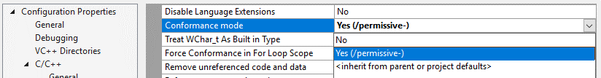
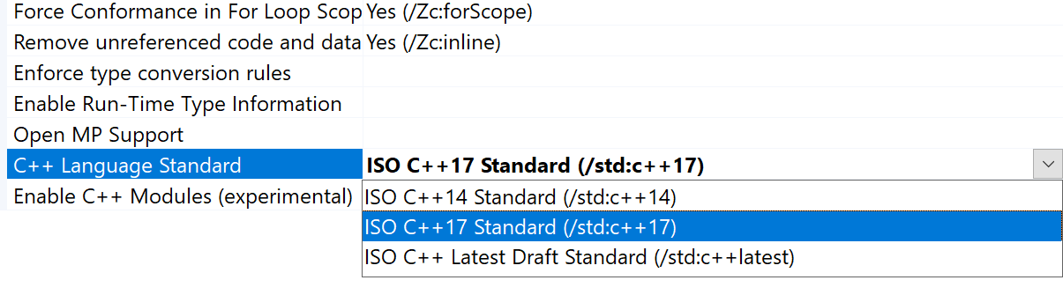
Compiler Switches
/permissive-
A “less permissive”, more conforming mode in the compiler
Off by default now… on by default at some point in the future
/Zc conformance switches available for fine-tuning /permissive-
/std:c++14
On by default, for now
The latest ISO-blessed C++ standard
i.e. standards features up to C++14
/std:c++17
/std:c++latest (tracks the latest C++ draft)
Off by default, forever
Every implemented feature that is not part of a finalized standard yet

Slide 8

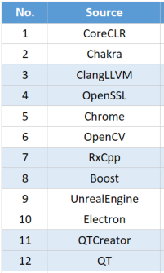
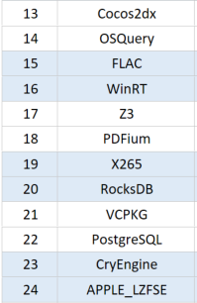
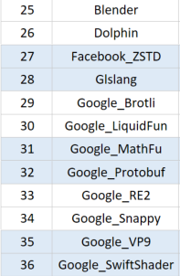
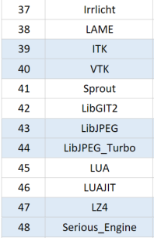
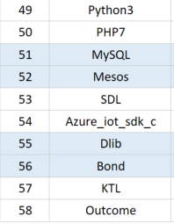
Conformance Testing with ~60 OSS Libraries from GitHub
Testing with GitHub master branches and compiler development trunk
MSVC default mode – 58 projects
MSVC /std:c++17 mode – 58 projects
MSVC /permissive- mode – 55 projects

Slide 9
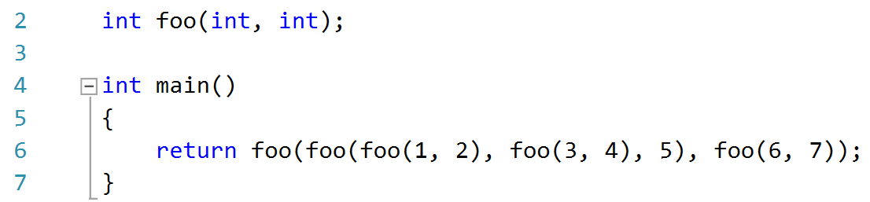
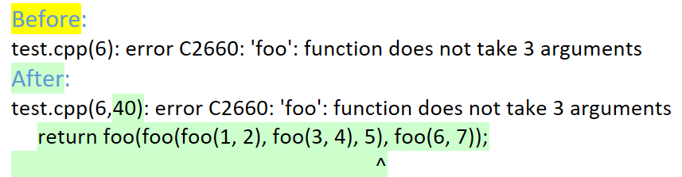
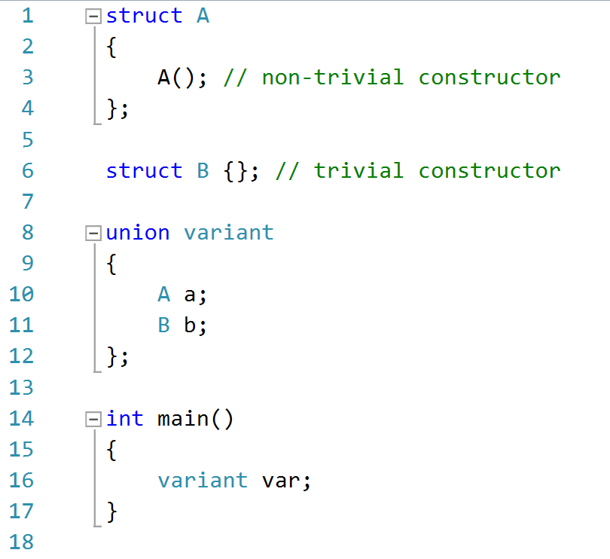
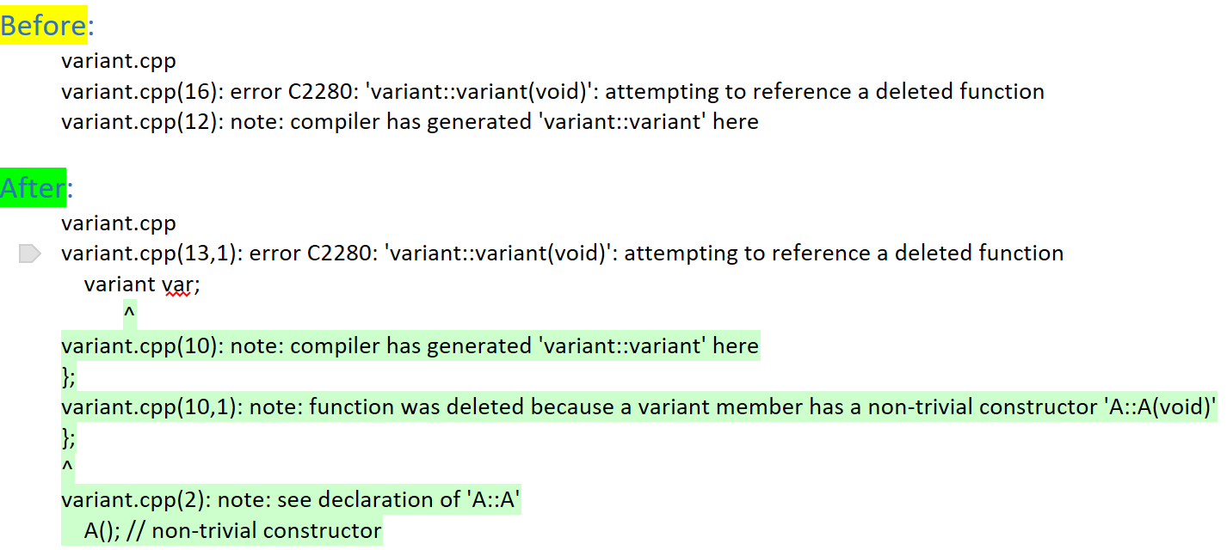
Compiler Diagnostics Improvements
Column Information and Source Context : /diagnostics:caret
Special Member Function errors

Slide 10
Continued Compiler Diagnostics Improvements
Template dependent name diagnostics
Member initialization order
Example | Current diagnostic (under /permissive-) | New diagnostic under /permissive-
template<typename T> void bar() { T::foo<int>(); // Should be T::template foo<T>(); } | test.cpp(5,17): error C2187: syntax error: ')' was unexpected here T::foo<int>(); ^ | test.cpp(5,8): error C7510: 'foo': use of dependent template name requires 'template' keyword T::foo<int>(); ^
template <typename T> void bar() { T::Type x; // Should be typename T::Type x } | test.cpp(5,13): error C2760: syntax error: unexpected token 'identifier', expected ';' T::Type x; ^ | test.cpp(5,5): error C7511: 'Type': use of dependent type name must be prefixed with 'typename' T::Type x; ^
struct X {}; template <class T> void bar() { typename X x; // Should be "X x" } | test.cpp(5,11): error C2760: syntax error: unexpected token 'identifier', expected 'id-expression' typename X x; ^ | test.cpp(5,11): error C7511: 'X': 'typename' keyword must be followed by a qualified name typename X x; ^
Example | Current diagnostic | New diagnostic
struct C { C (int a): y(a), x(y) {} int x; int y; }; | No diagnostics | warning C5038: data member 'C::y' will be initialized after data member 'C::x'

Slide 11

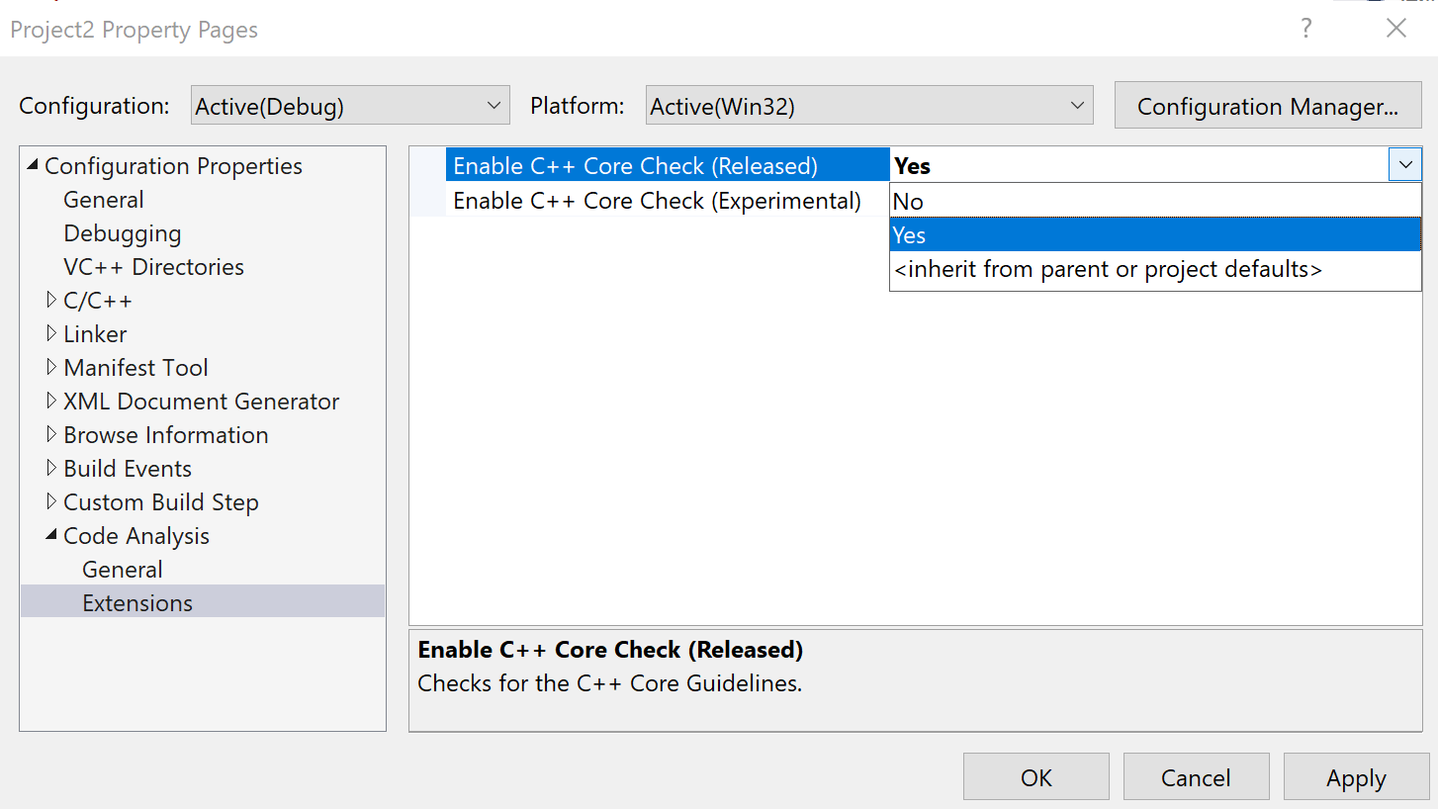
C++ Core Check to enforce the C++ Core Guidelines
Resource Management
Help with low-level resource management
Identify missing resource cleanup
Help with smart-pointer usage
Interfaces; Expressions and Statements
Guide better class declarations
Prevent use of dangerous constructs
Catch simple but hard-to-spot mistakes
Constants and Immutability
https://aka.ms/CppCoreCheck

Slide 12
Generated Code Quality: 8.9% better VS2015 -> VS2017
Taking advantage of the new SSA-based optimizer
Partial redundancy elimination
Common subexpression elimination overhaul, focus on eliminating loads
New control flow graph optimization module
Many inliner improvements
More aggressive and precise inline heuristic in the presence of C++ EH
Better leveraged information of single call-site and nested loops
Improved inlining for very small functions with and without PGO
Better cooperation with the _restrict keyword
Improved loop optimizations
Significantly improved loop unswitching
Significantly improved complete loop unrolling
Improved conditional vectorization heuristics
Improved speculative memset generation
New optimizations
SLP vectorizer & vectorization of min/max sequence reductions involving scalars
Scalar replacement to sink stores out of loops
SPEC 2017 Benchmark | VS 2015 Update 3 | VS 2017 15.5
602.gcc_s | 521 | 443
605.mcf_s | 572 | 546
620.omnetpp_s | 402 | 393
623.xalancbmk_s | 163 | 157
625.x264_s | 269 | 204
631.deepsjeng_s | 317 | 302
641.leela_s | 450 | 431
657.xz_s | 2247 | 2101
619.lbm_s | 943 | 869
638.imagick_s | 5721 | 4891
644.nab_s | 1907 | 1637
508.namd_r | 226 | 222
510.parest_r | 287 | 280
511.povray_r | 336 | 337
526.blender_r | 278 | 239
Measurements in seconds
Lower is better

Slide 13

Build Throughput
SPEC 2017 Benchmark | VS 2015 Update 3 | VS 2017 15.5
602.gcc_s | 145 | 132
605.mcf_s | 2.5 | 2
620.omnetpp_s | 85 | 65
623.xalancbmk_s | 189 | 147
625.x264_s | 28 | 24
631.deepsjeng_s | 5 | 5
641.leela_s | 11 | 9
657.xz_s | 10 | 6
619.lbm_s | 2 | 2
638.imagick_s | 54 | 46
644.nab_s | 6 | 6
508.namd_r | 15 | 14
510.parest_r | 205 | 158
511.povray_r | 27 | 22
526.blender_r | 221 | 189
Total buildtime: | 1005.5 | 827
Building SPEC 2017 is 20% faster end-to-end
When using /debug:fastlink, 2-4x faster
E.g, Fable, Forza, Chrome, Bing Maps
On by default in VS 2017, and mspdbcmf.exe integrated as part of Visual Studio build experience
IncrediBuild included free with VS 2017
Generates an improved build plan which breaks down false dependencies
Intelligent dynamic resource management (up to 8 cores with the FREE extension)
E.g., Qt from 942 to 844 seconds
E.g., ACE from 392 to 282 seconds
Build visualization and diagnostic tools to find build bottlenecks
Measurements in seconds
Lower is better

Slide 14
AGENDA
Microsoft Visual C++ (MSVC) Compiler and Libraries
Conformance
Compiler Diagnostics
Code Analysis
Code Gen Quality
Build Throughput
Visual Studio 2017
Faster installation and your disk will thank you
Pain-free upgrade
Just point Visual Studio to your code
Use Visual Studio for all your projects and target platforms
Be more productive than ever

Slide 15
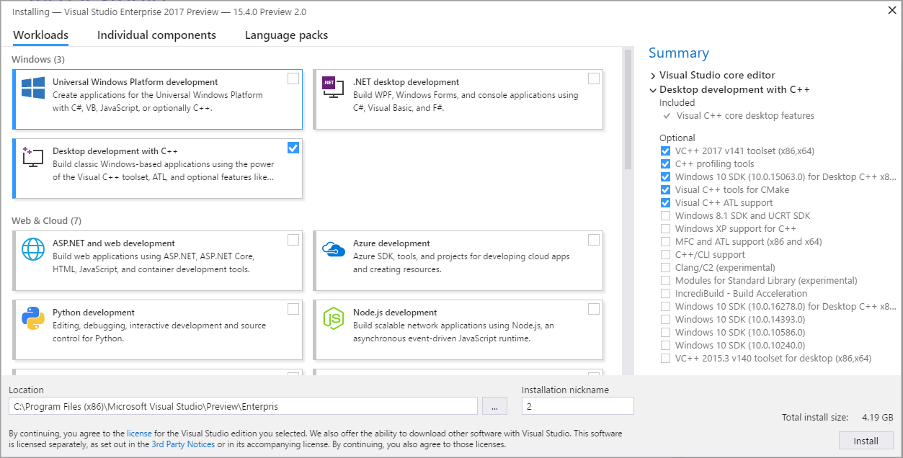
Visual Studio 2017
RTM 15.0
15.3
15.5
Aug 2017
Nov 2017
Mar 2017
15.6
??? 201?
https://aka.ms/vcinstaller

Slide 16
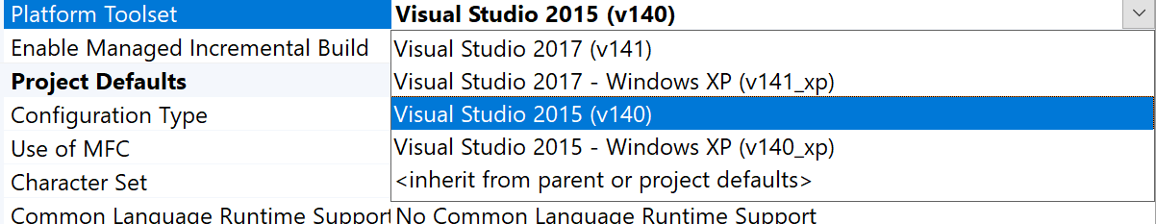
Pain-Free Upgrade to VS 2017
Install VS2015 toolset with VS2017 (without needing the VS2015 IDE)
Compiler Switches – “pay for play”
Binary compatibility between the VS2015 and VS2017 runtimes
Vcpkg for getting the latest version of open source libraries
Porting and Upgrading Guide: https://msdn.microsoft.com/library/dn986839.aspx

Slide 17







Vcpkg - Libraries Acquisition
80% of C++ projects use 2 or more 3rd party libs
A majority of them use open source libraries
Open source tool based on a port tree approach (Vcpkg)
Usage: vcpkg install boost
Installs the .h, .lib and binaries in a “lib folder” ready to use
350+ libraries in the catalog, added by 150+ contributors
Tuesday 8AM “Package management for C++ OSS libraries on Windows with vcpkg”
https://github.com/Microsoft/vcpkg

Slide 18
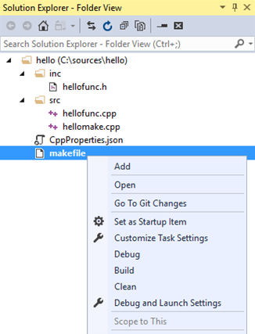
Open Folder, CMake etc
Ideal for non-MSBuild projects
Work with any project, e.g. CMake, make, and other C++ build systems
Cross-platform development with MinGW and Cygwin
Easy to get started
devenv.exe <directory>
“File > Open > Folder…” (Ctrl+Alt+Shift+O)
Read, Navigate, Edit
All C++ navigation and IntelliSense features
Build, Debug
Flexible integration of external build processes
Familiar Visual Studio debugging experience

Slide 19
AGENDA
Microsoft Visual C++ (MSVC) Compiler and Libraries
Conformance
Compiler Diagnostics
Code Analysis
Code Gen Quality
Build Throughput
Visual Studio 2017
Faster installation and your disk will thank you
Pain-free upgrade
Just point Visual Studio to your code
Use Visual Studio for all your projects and target platforms
Be more productive than ever

Slide 20
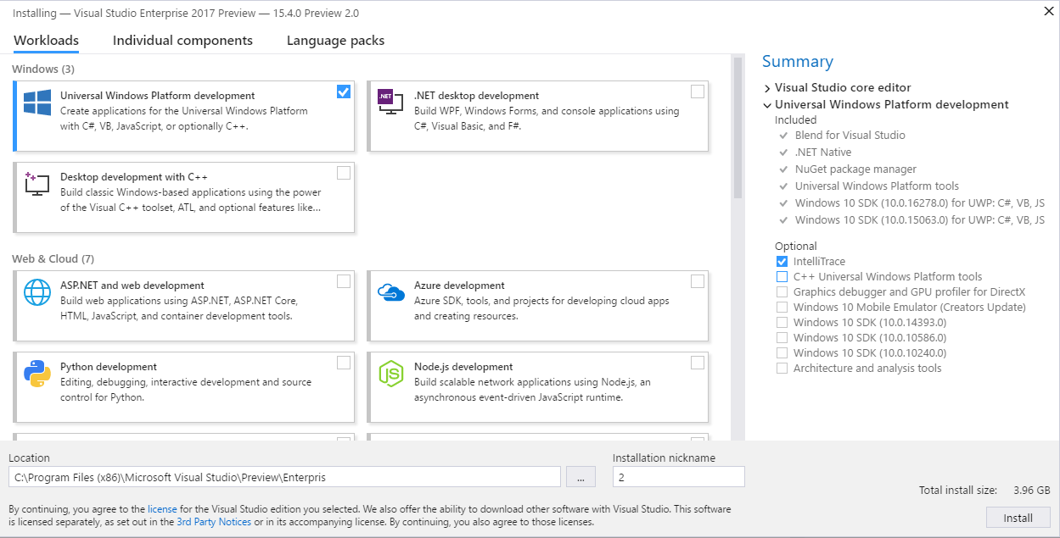
REPLACE WITH ONE SHOWING UWP SELECTED

Slide 21

Windows, Windows Store
Universal Windows Platform (UWP)
New way to target Win10 Desktop, Mobile, Xbox, and HoloLens from a single binary
Accelerated OpenGLES 1, 2 and 3 support through Angle OSS library
Large game deployments to Xbox
C++/WinRT - a language-extension-free WinRT projection for C++ (https://github.com/Microsoft/cppwinrt)
Bridges to Windows Store
Desktop Bridge “Centennial” - Packaging your desktop apps in the Store
Windows Bridge for iOS “Islandwood” (https://github.com/Microsoft/WinObjC)
Share source code across Windows Desktop, UWP, Android, iOS, and Linux

Slide 22
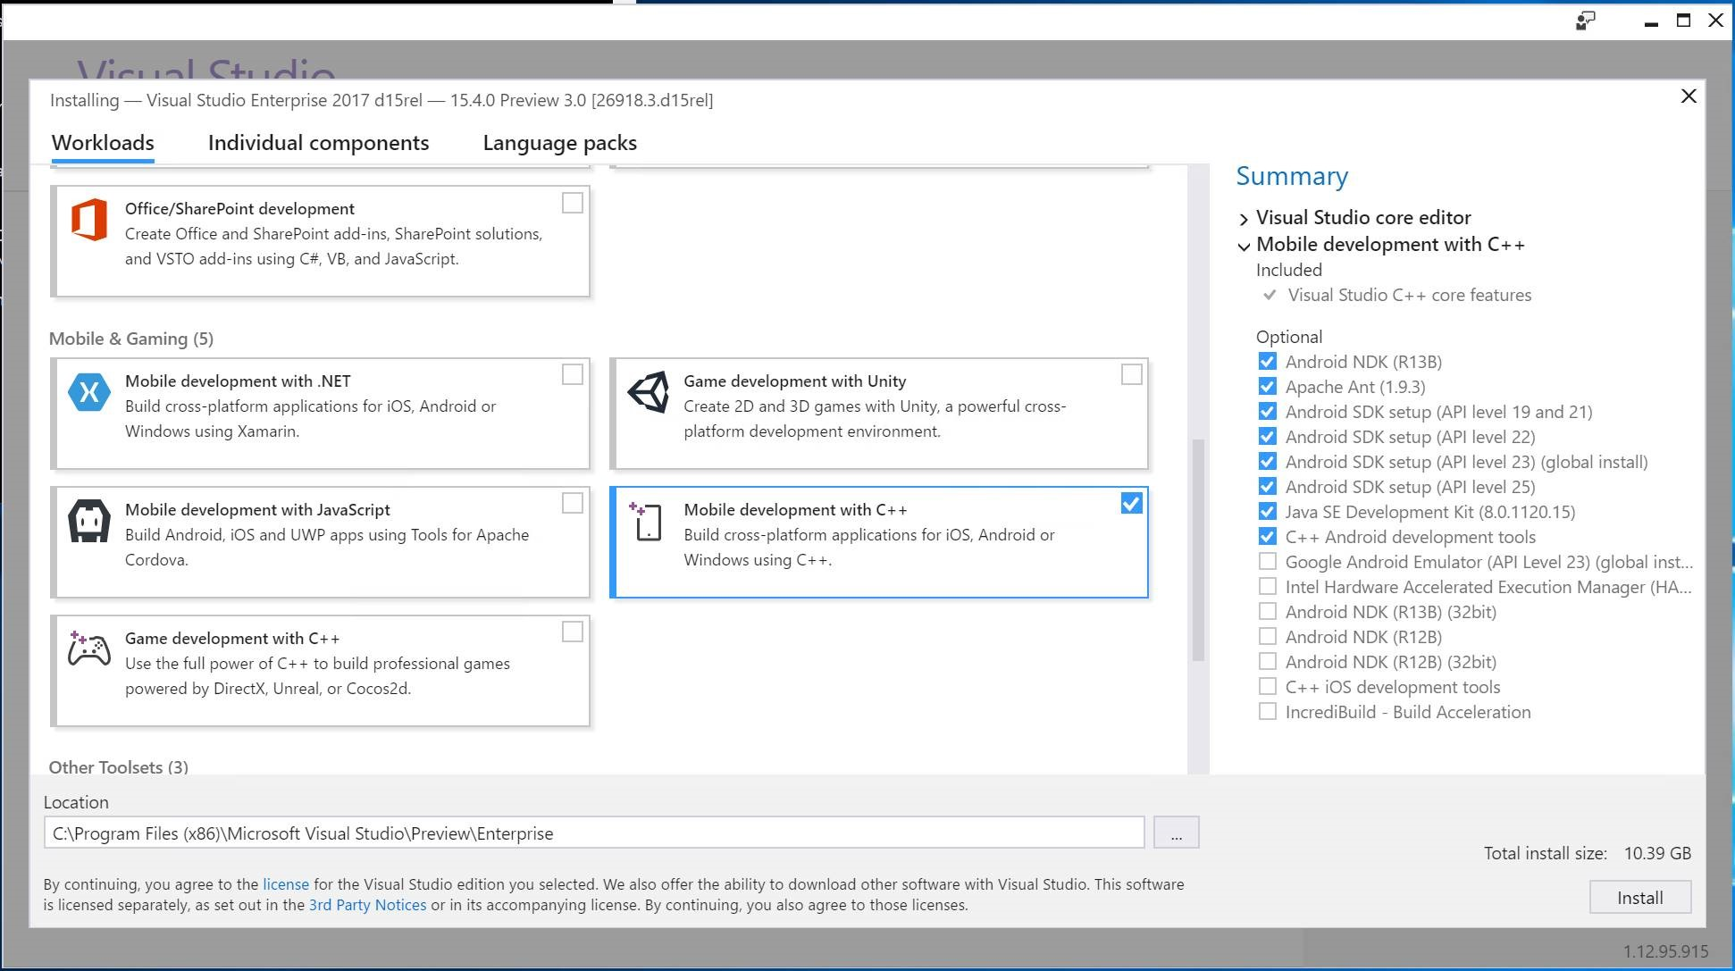

Slide 23

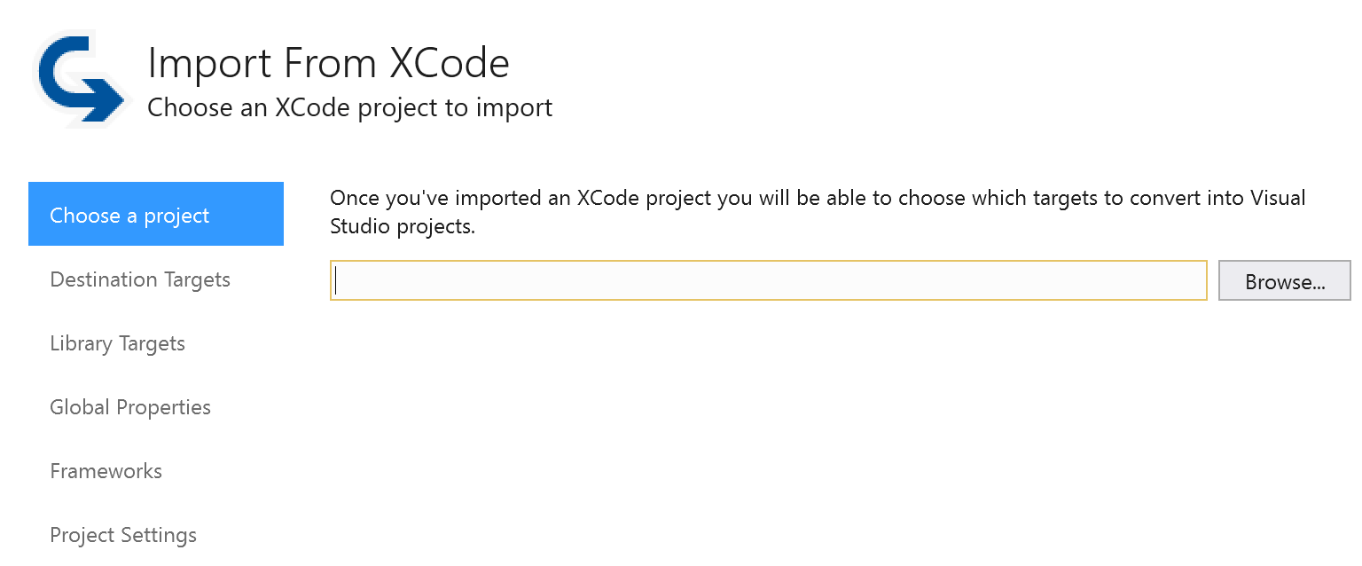
Android and iOS
Android
C++ IntelliSense and debugging
Java IntelliSense and debugging
Support for Android Gradle build system
Built-in support for Android API level 25 and NDK r15c in upcoming VS updates
iOS
Easily import (and roundtrip) your Xcode project into Visual Studio
https://visualstudio.com/vs/cplusplus-mdd/

Slide 24
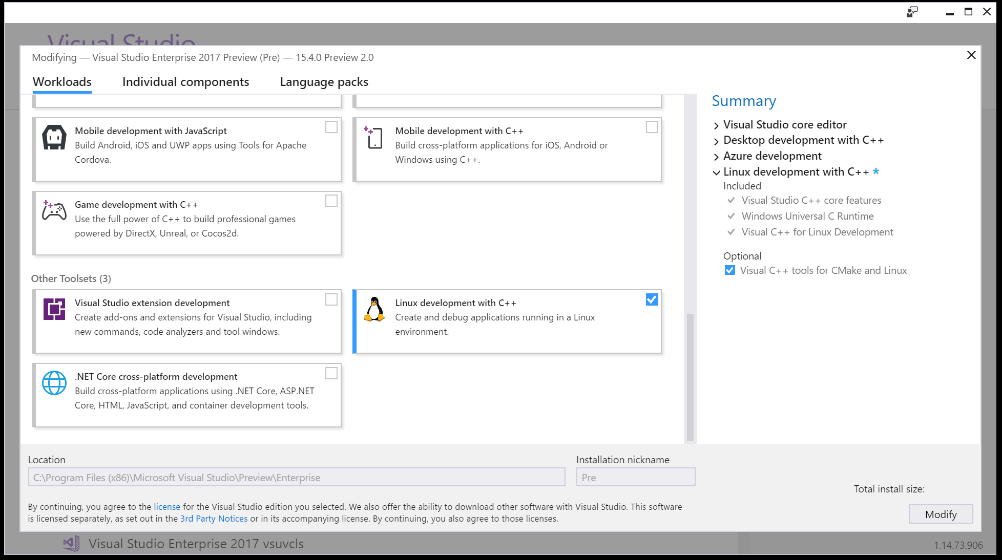

Slide 25
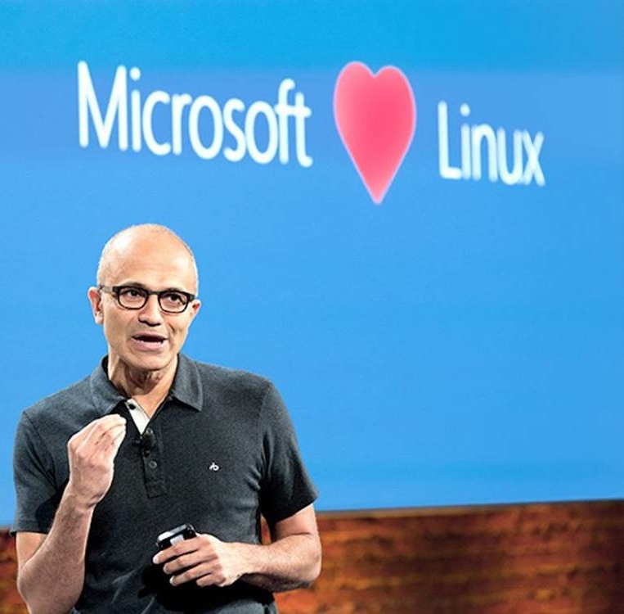
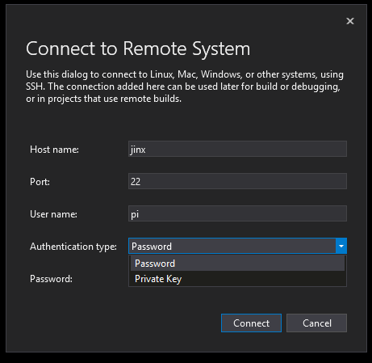
Linux
Use Visual Studio with any Linux distro or Windows Subsystem for Linux (WSL)
Remote system needs SSH, GDB, and GCC for compile
Connect using user/password or private key
Project templates enable control of GCC/GDB on remote target
IntelliSense supports GCC with standard Linux libraries out of the box
Debug from your projects or attach to remote process
Use either gdb or gdbserver on the remote
Python pretty printer type visualizers supported in gdb mode
Support for CMake > 3.8 added in 15.4
Resources
Documentation: https://aka.ms/vslinux
Issues, discussion: https://github.com/microsoft/vslinux

Slide 26

IoT – Internet of Things
C++ for Linux Development works with IoT devices running Linux
E.g. Raspberry Pi, Beaglebone
Yocto SDKs can be used by overriding project defaults
Visual Studio 2017 version 15.5 introduces ARM GCC support
Local cross compile use ARM compiler
mbed folder based project support
Launch templates provided to illustrate how to debug devices
The Azure IoT SDK supports Linux and MCU devices
Portable to very small devices
Provides message processing and device management capabilities
Any device with network capability can get messages to/from Azure
Devices without network capability can communicate through gateways
https://azure.microsoft.com/develop/iot/

Slide 27
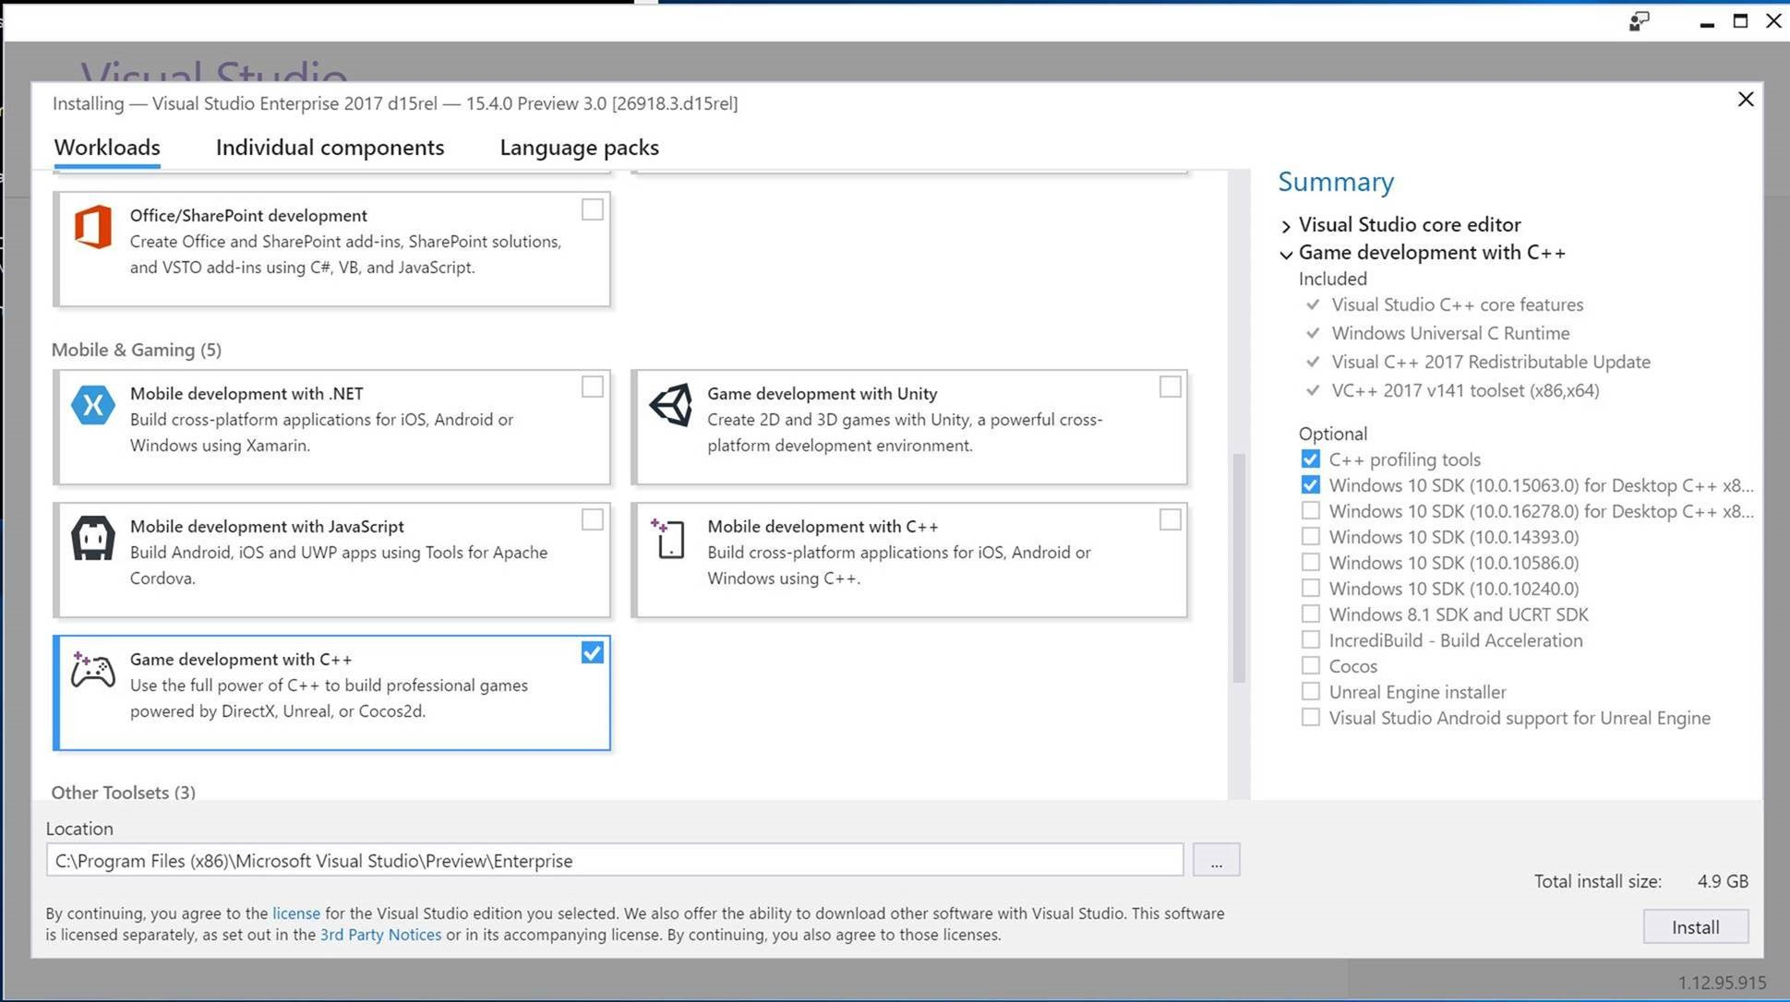

Slide 28


Games
Use the cloud to build, launch, and scale out your games
https://azure.microsoft.com/solutions/gaming/
Built-in graphics debugger and profiler for DirectX 10, 11, 12 for diagnosing graphics issues and performance bottlenecks
Use Visual Studio to build cross-platform games with popular game engines
Unity, Unreal engine, and Cocos
https://www.visualstudio.com/features/game-development-vs

Slide 29
AGENDA
Microsoft Visual C++ (MSVC) Compiler and Libraries
Conformance
Compiler Diagnostics
Code Analysis
Code Gen Quality
Build Throughput
Visual Studio 2017
Faster installation and your disk will thank you
Pain-free upgrade
Just point Visual Studio to your code
Use Visual Studio for all your projects and target platforms
Be more productive than ever

Slide 30

Productivity
Code Editing
Predictive IntelliSense, IntelliSense filtering, Code formatting enforcement with editorconfig
Coming soon: Ctrl + Click to Go To Definition, Structure Visualizer in-box (download the extension in the meantime)
Code Navigation
Manage a large list more easily with Find All References (better perf coming in 15.5)
Navigate To -> Go To with filtering
Improved Error List results
Source Control Management
Force push your changes, SSH support for remotes, View Commit Diff
Debugging/Diagnostics
Run to Click, Reattach to Process, Improved Exception Helper, Break-on-exception conditions, Improved Memory and CPU profiler
Unit Testing
Test Adapter for Google Test
Test Adapter for Boost.Test
…

Slide 31
Performance
Auto-precompiled headers for IntelliSense perf (when no PCH)
Memory usage during debugging significantly decreased
E.g. debugging a specific problematic project down to 1.9G from… crashing
Solution load dramatic improvements
Chromium - 4600 Solution Items | VS 2015 Update 3 | VS 2017 | Improvement
Time - First Solution Open (s) | 1,213 | 182 | 6.6x
Time – Subsequent Solution Open (s) | 1,211 | 68 | 17.8x
Private Working Set (MB) | 2,293 | 804 | 2.8x
Virtual Memory (MB) | 3,066 | 1,302 | 2.3x

Slide 32
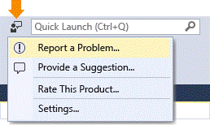
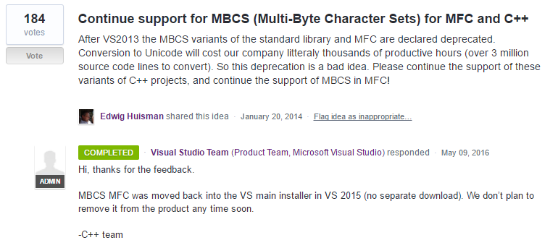
You Helped Us Build It!
Visual Studio User Voice https://visualstudio.uservoice.com/
“Report a Problem…” tool https://developercommunity.visualstudio.com
2,887 Votes
on UserVoice
1,376
fixed bugs publicly reported through Connect & IDE

Slide 33
Summary
Visual Studio Code
Code editor redefined, optimized for editing and debugging your C/C++ code
MSVC - Visual C++ toolset (compiler and libs)
The obvious choice on Windows
Visual Studio 2017
Fast and easy workload installation, Pain-Free Upgrade, Open Folder
Performance you can feel
Most productive IDE for your editing, building, debugging
Any C++ developer, building any type of app
No matter what platform you are targeting
Microsoft
We are listening and participating, tell us what you want to see next

